Slide 1
Utah Environments
Our New Science Unit

Slide 2
Vocabulary Words to Know
Wetland- a low area where land is soaked with water
Desert- an area of land that receives less than ten inches of rainfall a year
Forest- a large area of land that is covered with trees

Slide 3
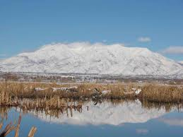
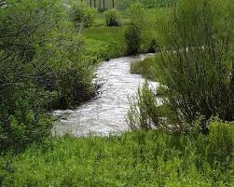
This is a Wetland…

Slide 4
Wetlands
Are wet most of the year because the soil soaks up the water and holds it in.
Lie between dry land and open water along rivers, lakes, and streams, or places where the land is low.
Rain is important- too much flood, too little dry up

Slide 5
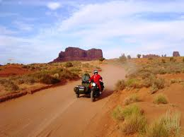
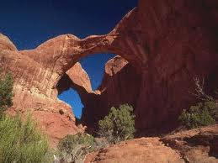
Desert

Slide 6
Desert
Hot summer, cold winter
Less than 10 inches of rainfall a year
Animals have to adapt to survive

Slide 7
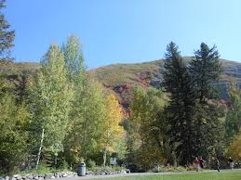
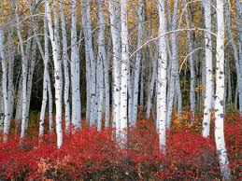
Forest

Slide 8
Forest
Trees, coniferous and deciduous
Mountain slopes
Camping
Wild animals

Slide 9
Now look at your shared reading…
You will become the expert on your habitat.
Write down 5 plants
Write down 5 animals
Precipitation
Temperature
Surface Terrain

Slide 10
Jigsaw
What habitat did you choose
Get with two other people with different habitats
Share about your habitat

Slide 11
Now let’s fill out the Venn Diagram
Wetland
Forest
Desert
Precipitation, temperature, surface terrain, animals, plants
5 in each

